Slide 1
STAP, re- and upskilling in the Netherlands
Niels Lieman, UWV

Slide 2
STAP (improving labour market position)
  New arrangement for UWV. Project started in 2019.
  Introduced in 2022, replacing a tax scheme to promote education.
  STAP arrangement (160 mln)
  €1000,- per year for training, once a year.
    Older than 18 younger than pension age.
    EU citizen, not in other formal education.
    Training must be approved and registered by DUO .
    4 tranches per year.

Slide 3
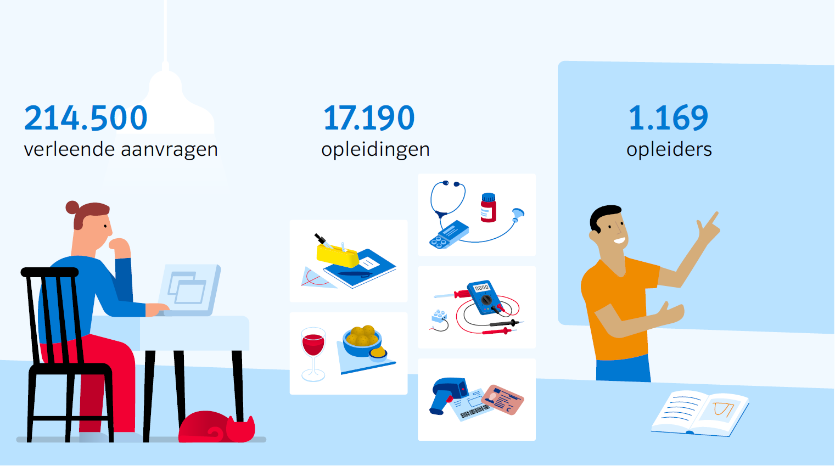
STAP arrangement in 2022
Granted applications
Trainings
Educational institutes

Slide 4
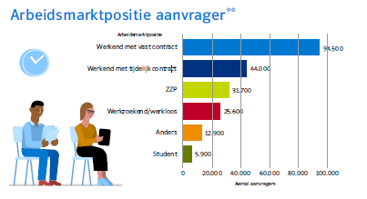
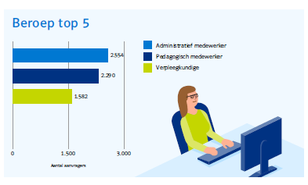
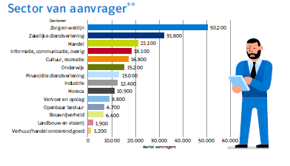
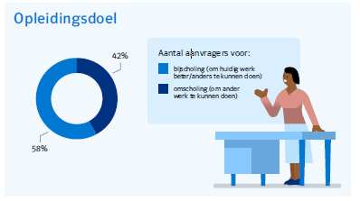
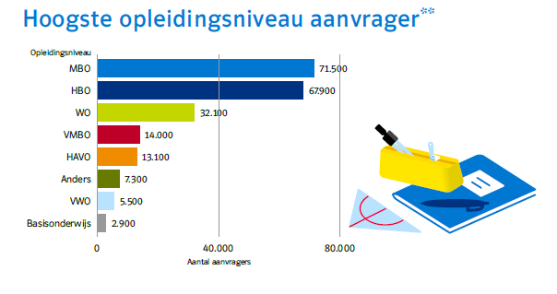
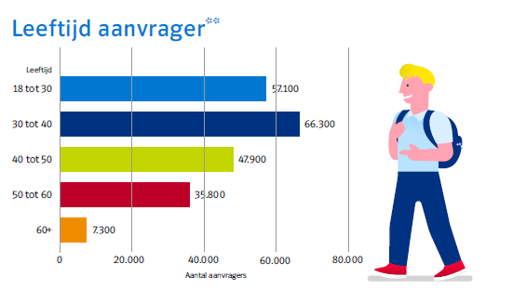
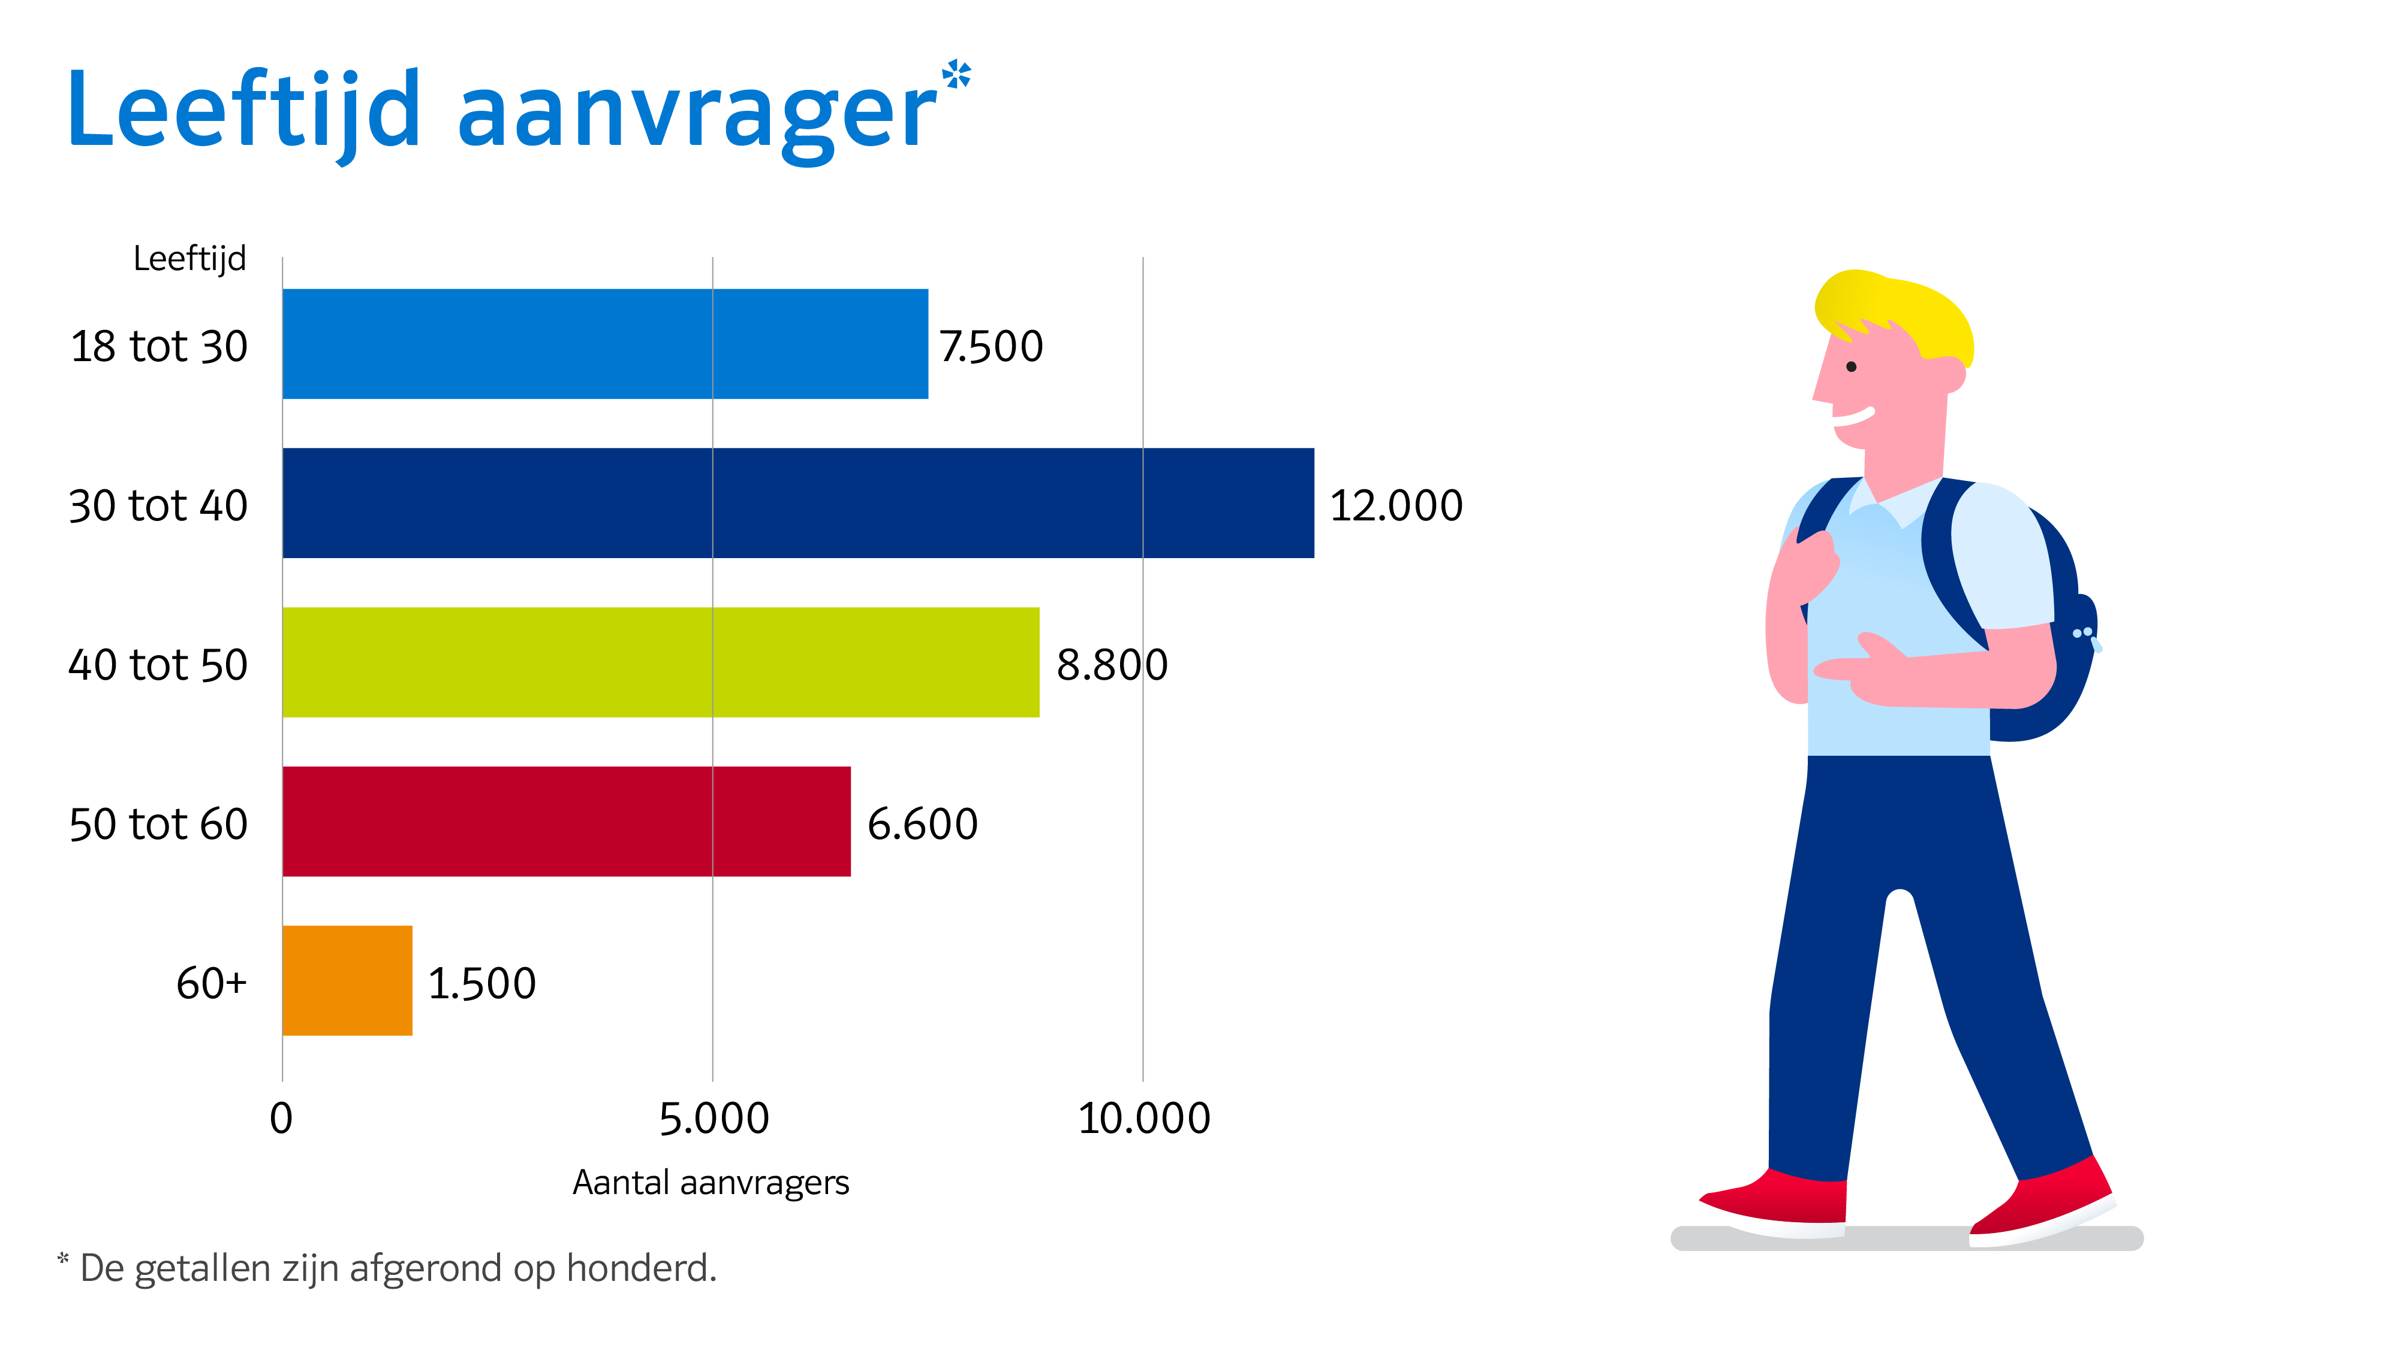
STAP arrangement results 2022
Labour market position
Occupation
Sector of applicant
Permanent contract
Administrative employee
Pedagogical occupations
Nurse
Healthcare
B to B services
Trade
Communication
Culture & Leisure
Education
Finance
Industry
Hotel & Restaurant
Transportation
Public institutions
Construction
Agriculture & fishery
Real estate
Temporary contract
Self-employed
Jobseeker
Other
Student
Education objective
Highest degree of education
Age of applicant
Purpose
Vocational education
Upskilling (to stay in current occupation)
Bachelor
Master
Reskilling
Lower secondary
tekst
High school
Other
High school
Primary school
Notes:
A total of over 214,000 STAP applications were made in 2022. More than half of the applicants are educated up to MBO-4. One in fiveapplicants are 50 years old or older. Over half (53%) are between 30 and50 years old. Just over a quarter (27%) of applicants are youngerthan 30 years old. Over half (58%) of applicants want to use theSTAP budget to retrain to do their current job better,42% want to retrain or create the opportunity to do other workwork. Applications were made to 1,169 different training providersand 17,190 different courses or training were applied for.Of the 214,000 applicants, 44% have a permanent contract, 20% have atemporary contract, 15% are self-employed, 12% are job seekers/unemployed, 3% indicatestudents and 6% do not know their labour market position.is. The applicants come from 14 different sectors. Almost a quarter(23%) work in healthcare, 14% come from ICT (8%) or industry (6%)and 7% are employed in education. With15% relatively well represented, as is trade (10%).Translated with www.DeepL.com/Translator (free version)

Slide 5
Evaluation & appreciation
Basic infrastructure for providing training is implemented successfully. In the coming year we will increase STP from 60% to 90%.
Digital labour market advice as a guide to occupations and training choice introduced.
High visitor numbers and positive feedback-Scheme leads to unwanted effects and action by limited group of trainers.

Slide 6
Future plans
In 2023/2024-STEP infrastructure ready for differentiations in training, subsidy amount, subsidy pots, target group characteristics, etc.
Implementation of learning rights: 4 x 125 ml next resources up to MBO 4 level-Include multi-year training in the training register. Is a bottleneck for realisation and implementation. DUO, UWV and trainers have different views
Previously acquired competences to be included in the training register
Multi-year perspective-The infrastructure is in place
Focus on courses that are truly labour market-oriented
STAP as part of the total LLL spectrum
Cooperation with sectoral training funds

